Slide 1
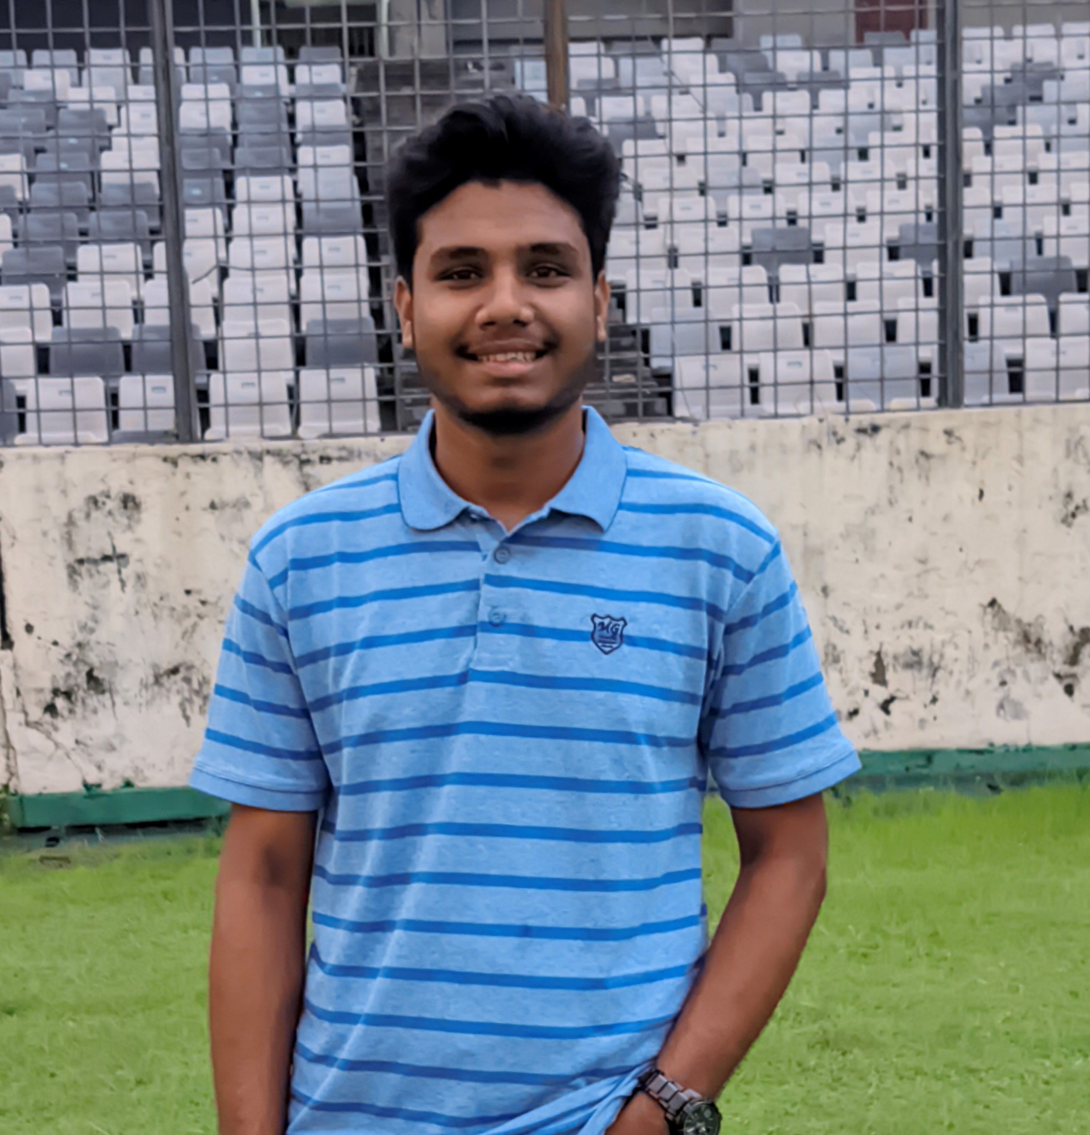
Industrial Attachment::About Me
Nahidul Islam Shakin
Student ID: 18CSE246
Department of CSE, BSMRSTU

Slide 2
Impact of Industrial Attachment
Professional Network
Work Environment Adaptation
Meeting Process of client
Team Formation
Work Process
Version Control & Team Collaboration(Git & GitHub)
Project Delivery System
Official Work System

Slide 3

Honorable Trainer’s
Anup Kumar Roy
Sr. Software Engineer
Coder71 Ltd, Mirpur DOHS, Dhaka
E-mail: anup@coder71.com
Kayes Ashfaq
Mobile App Developer
Coder71 Ltd, Mirpur DOHS, Dhaka
LinkedIn: kayesashfaq

Slide 4




About Coder71 Ltd.
Coder71 Ltd. is an established web development company.
S M Mehedi Hasan is a Founder & MD of Coder71 Ltd.
Coder71 was founded in 2015.
Coder71 Ltd.
Jawad Tower, House#74, Level#7, Flat#8A, Zoo Road, Block#D, Section#2, Mirpur, Dhaka-1216, Bangladesh
info@coder71.com
https://www.coder71.com

Slide 5








Coder71::Services
Web Design
Web Development
E-Commerce
CMS
Mobile Apps
Digital Marketing
Graphics Design
Domain Hosting

Slide 6





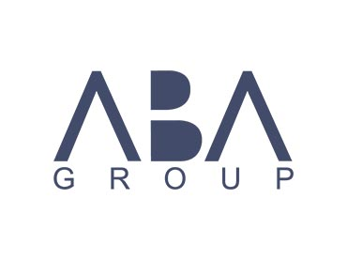





Coder71 :: Feature Clients

Slide 7
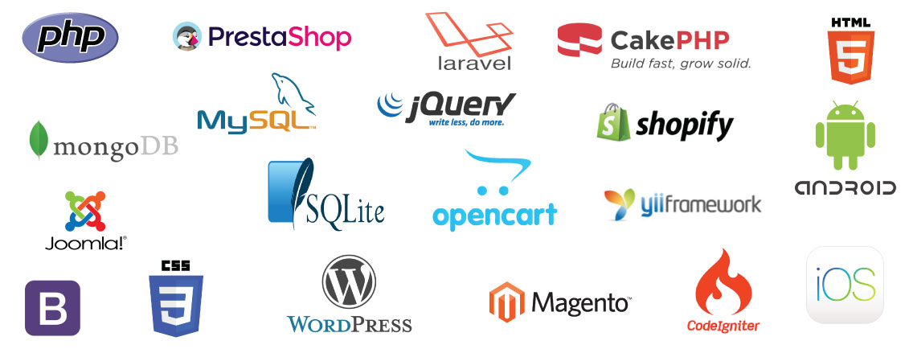
Coder71::Development Platform

Slide 8
Meeting Process of Client
Initial Meeting
Project Proposal
Planning
Development and Testing
Client Review
Deployment
Support and Maintenance
Project Closure

Slide 9
Team Formation
Define Roles
Assess Existing Skills
Hiring
Team Communication
Project Plan
Use Tools
Training
Testing
Feedback

Slide 10
Work Process
Initiation & Planning
Requirements Analysis
Design & Development
Testing & Deployment
Monitoring & Maintenance
Documentation
Training
Review & Closure
Post-Implementation Evaluation

Slide 11
Version Control & Collaboration Tools
Git & GitHub
Code Editing
Code Add & Commit
Code Push
Code Maintaining
Git Branch & Merge

Slide 12
Project Delivery System
Statement of Work
Project Contract/Agreement
Change Order Agreement
Intellectual Property (IP) Confidentiality Agreement
Payment Schedule
Acceptance Criteria
Liability Limitations
Delivery and Acceptance
Exit Strategy

Slide 13
Thank You All

